Slide 1

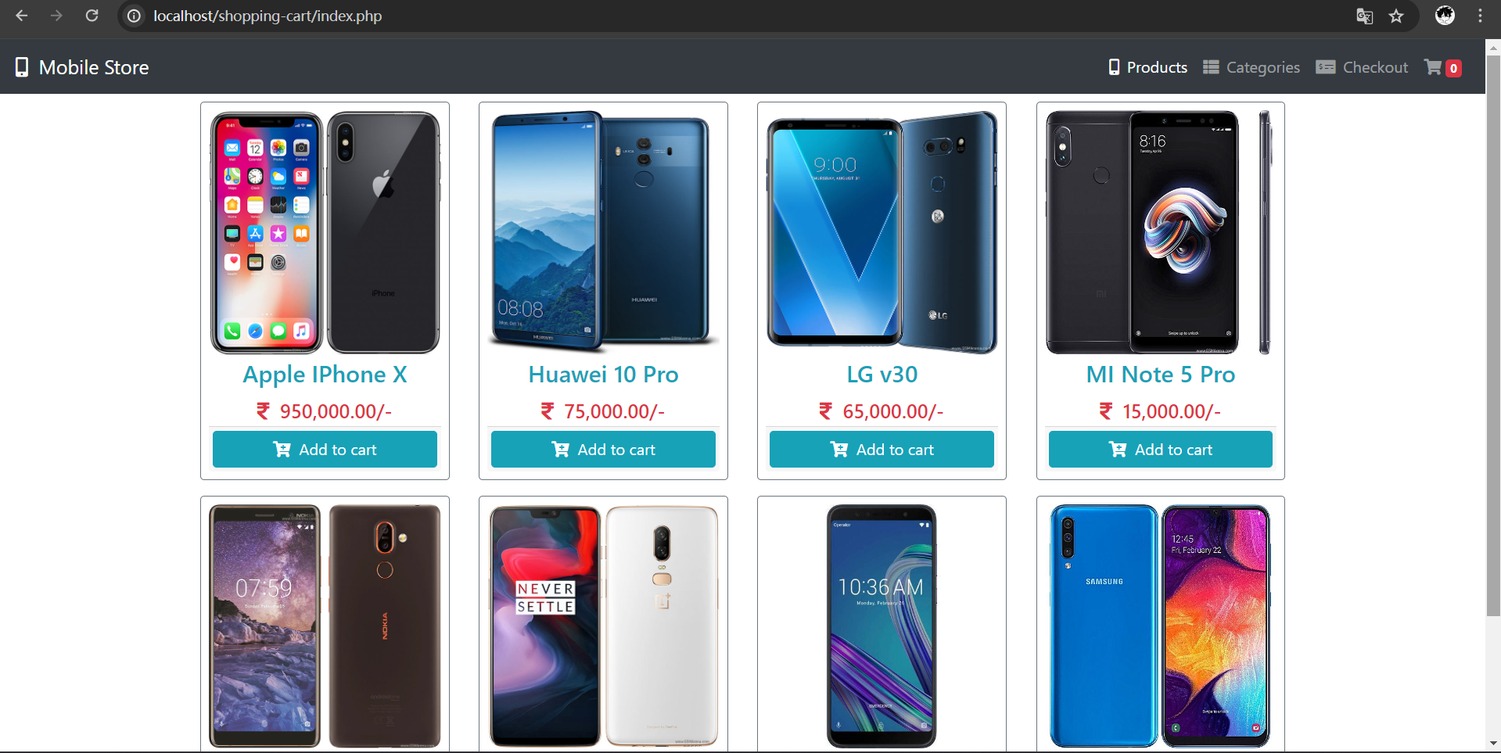

Shopping Cart With Checkout System
CISC3003-Individual Work of Project Assignment
LEI CHAK FONG
DC126114

Slide 2

Overview
Introduction
The main function
TECHNICAL VISION
WEB PAGE INTRODUCTION

Slide 3
Introduction
We have developed a shopping website dedicated to mobile phones where you can easily browse a wide range of mobile phones and compare specifications. Once you find a phone you like, you can add it to your shopping cart. You can view your cart, manage quantities, or add or delete stores at any time, then proceed to checkout.
Our checkout offers a variety of payment options, providing flexibility and convenience. All you need to do is provide your personal information and address, then select your payment method to checkout to complete the transaction.

Slide 4
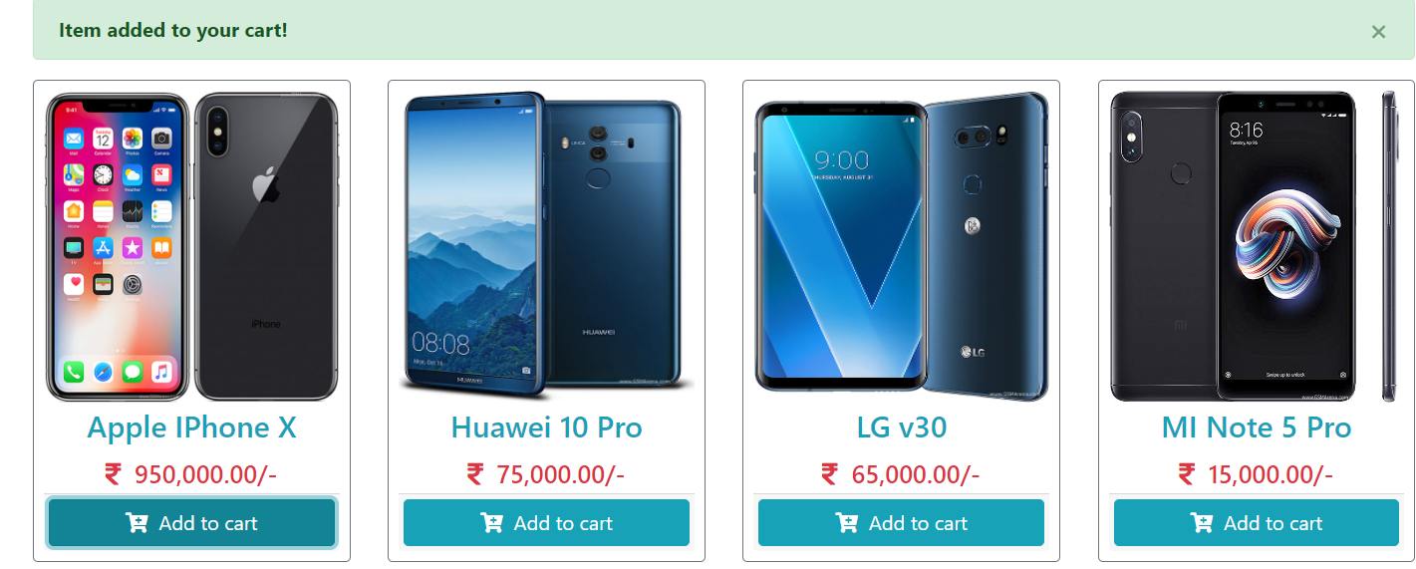
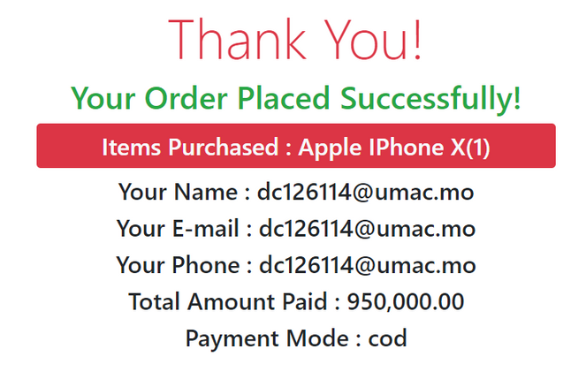
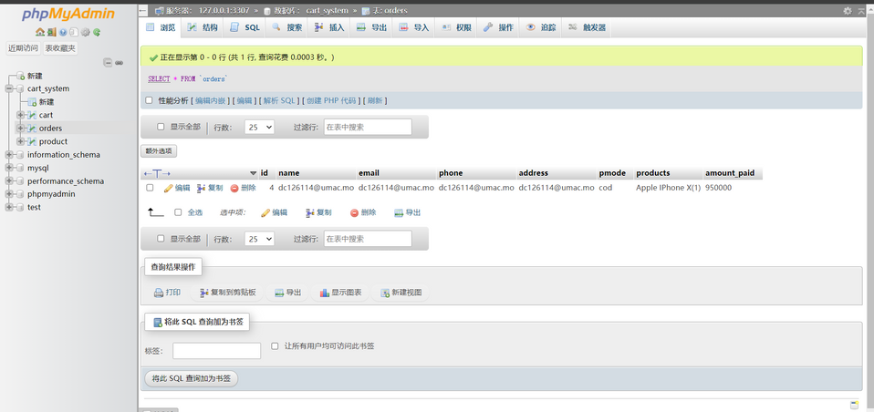
The main function
Add to cart
Checkout
Store data
Once you find a phone you like, you can add it to your shopping cart.
You can view your cart, and manage quantities at any time, then proceed to checkout.
Provide your personal information and address, then select your payment method to checkout to complete the transaction.
All information about products, orders and shopping carts are stored in the database. You can log in to the database to view and modify the data at any time.

Slide 5

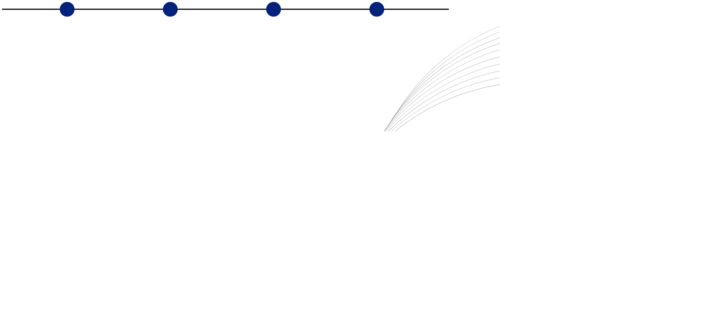
TECHNICAL VISION
01
01
02
03
04
HTML & Bootstrap 4
PHP
MYSQLi
phpMyAdmin

Slide 6


WEB INTRODUCTION

Slide 7
Home page

Slide 8


Slide 9
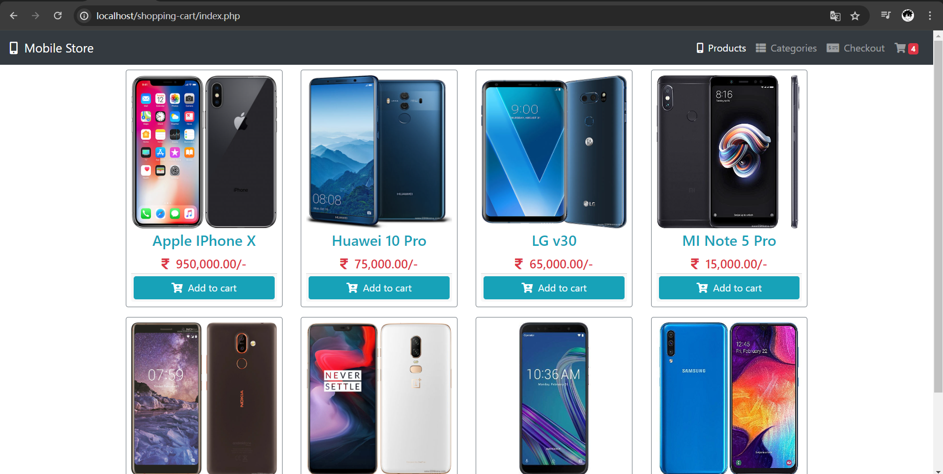


Slide 10
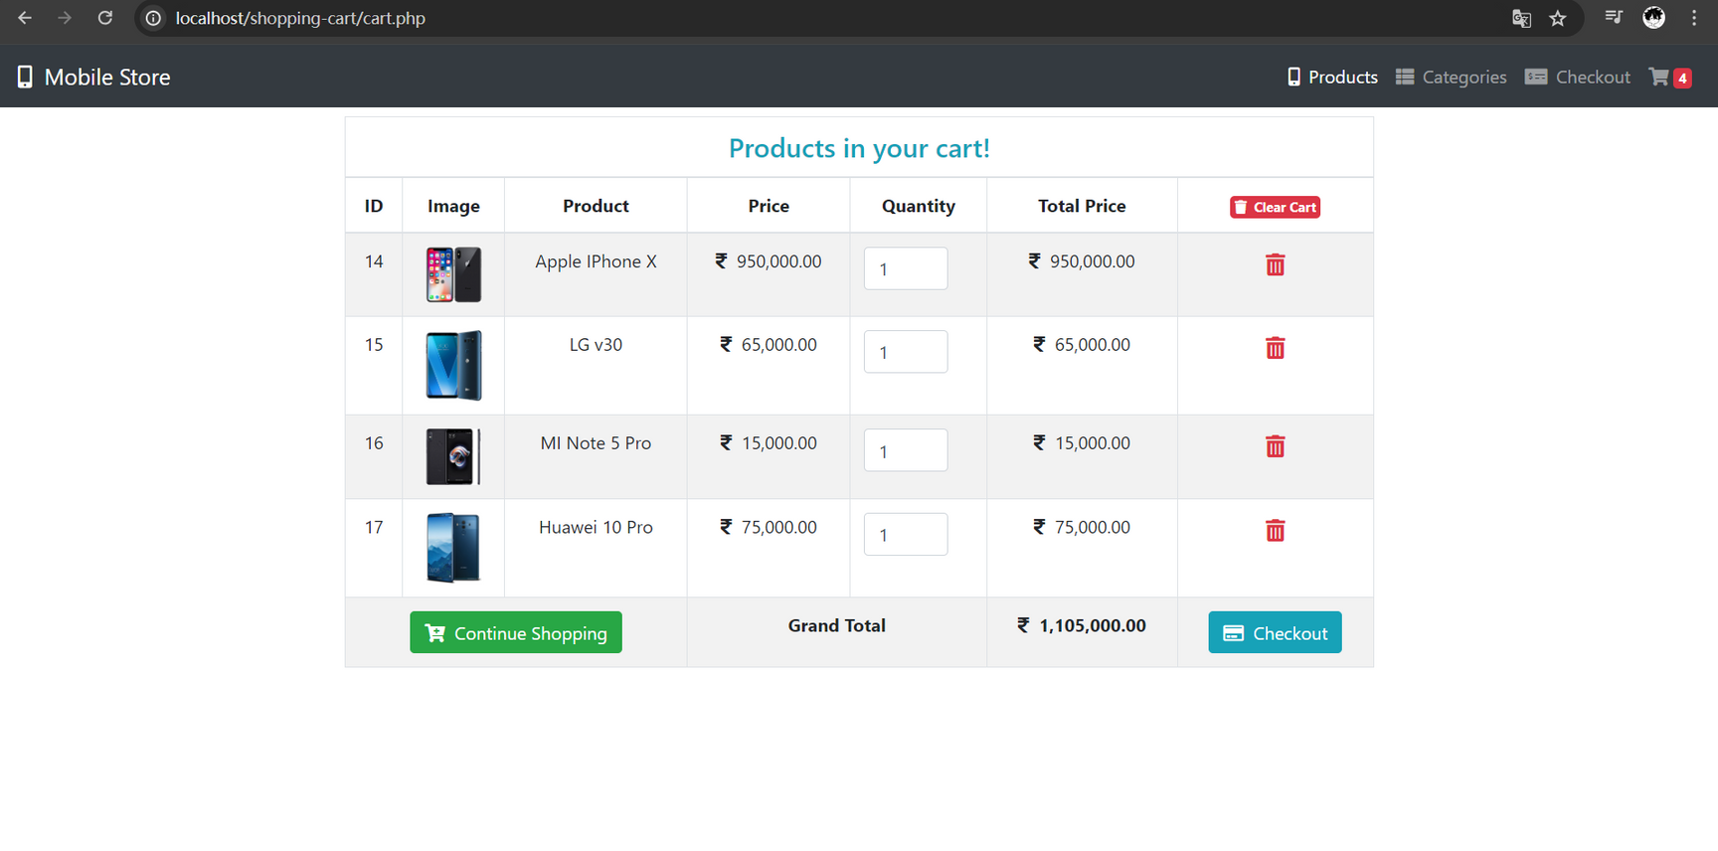
Cart page

Slide 11

Checkout

Slide 12
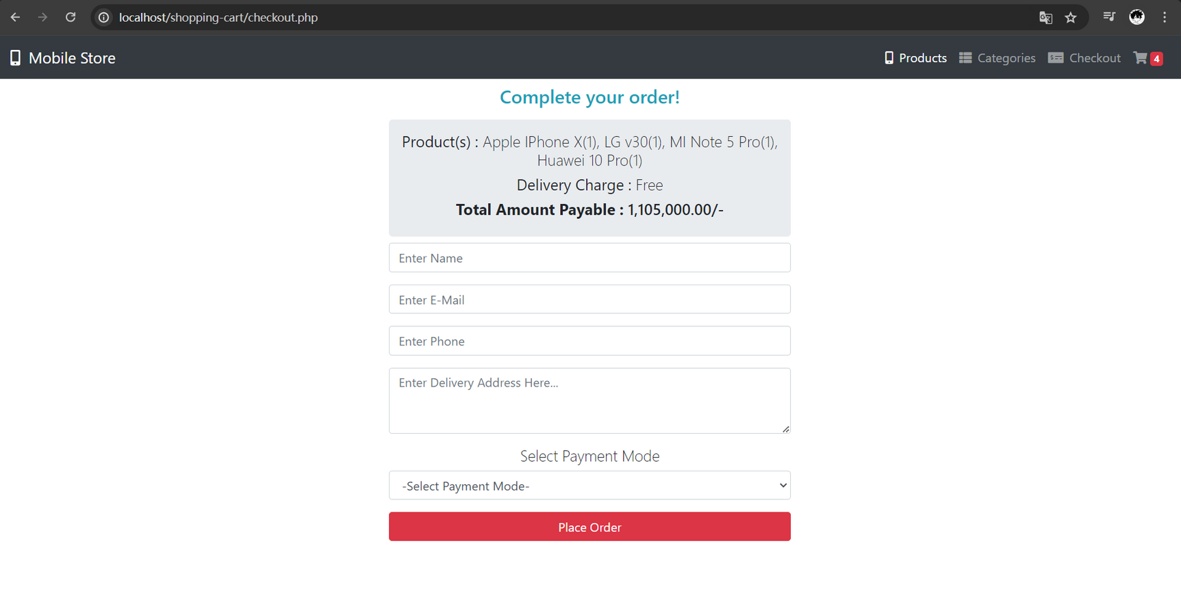
Checkout page

Slide 13
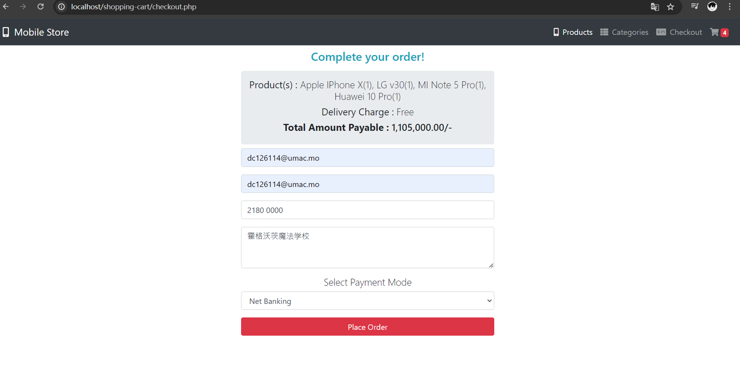


Slide 14
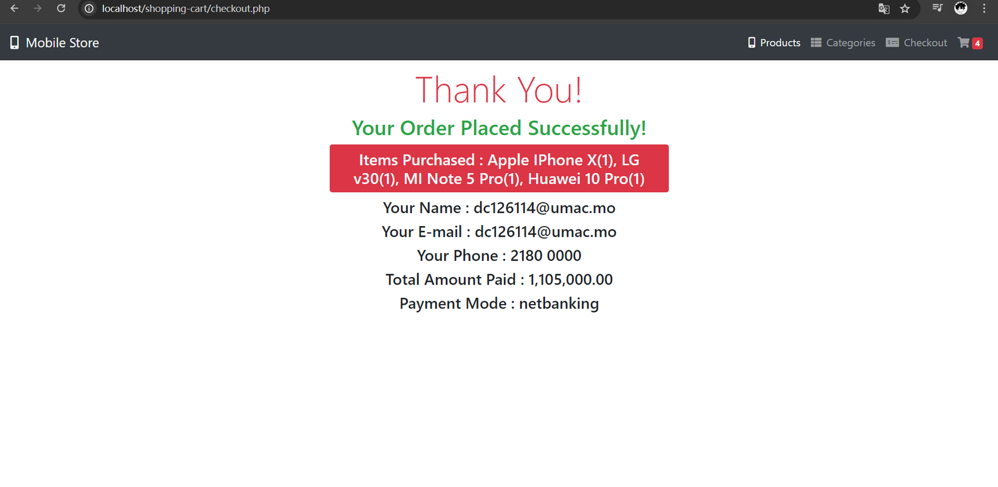
Congratulations!!! you get the new phones

Slide 15
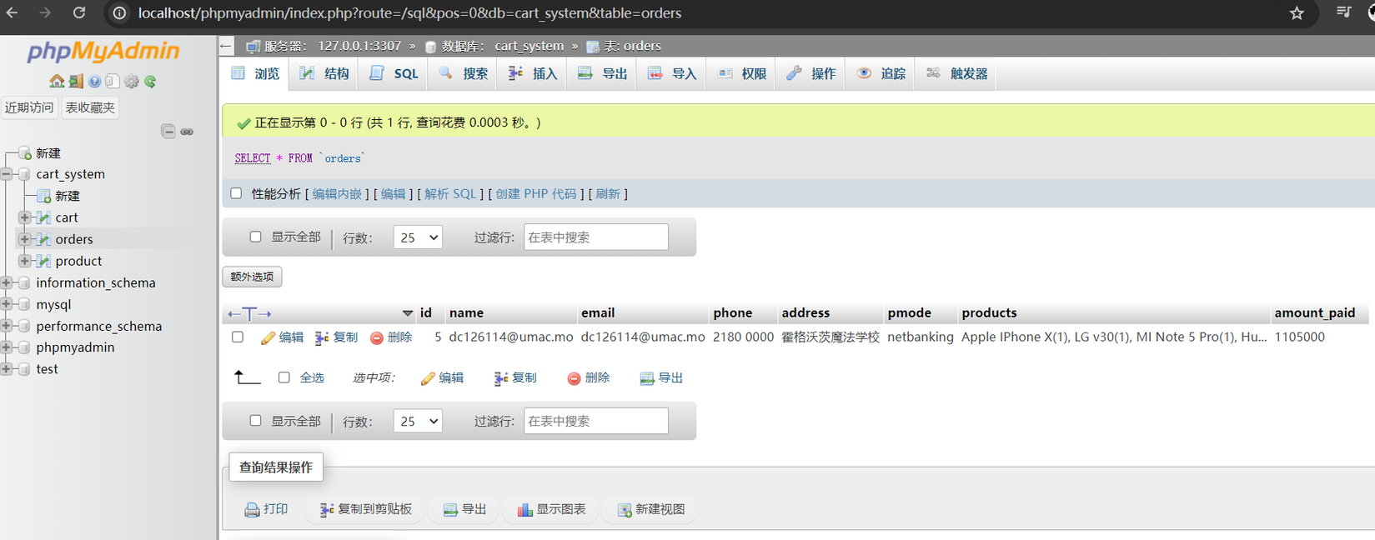
Orders--Data Store

Slide 16



THANK'S FOR WATCHING

